Slide 1
Overview of Noise Related Issues in New York City
Presented by Vinay Sridhar

Slide 2
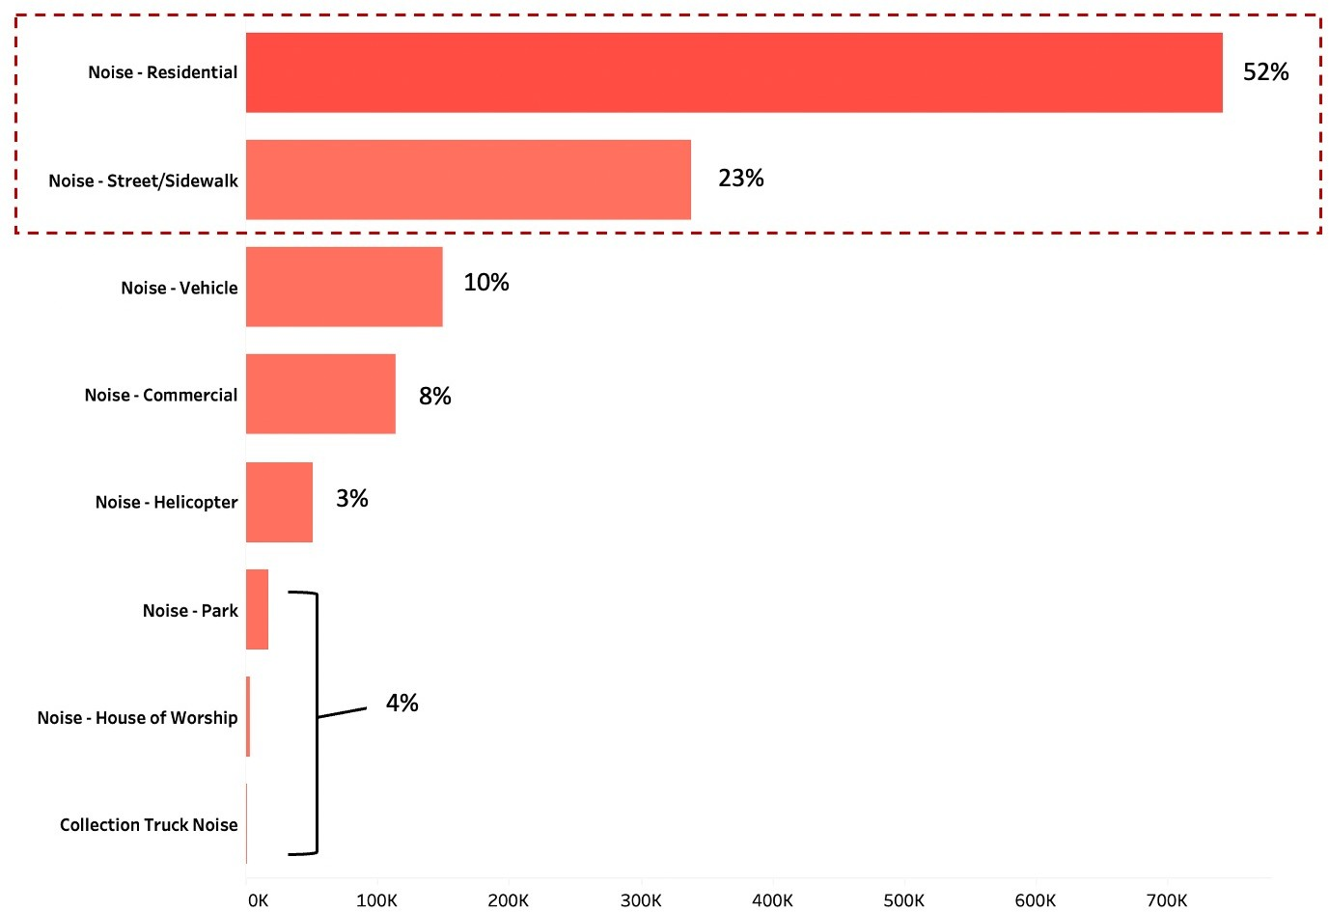
Noise from Residential Areas and Streets Account for ~75% of Complaints
In the last 3 years, Noise from Residential complexes and sidewalks/streets have attracted nearly 1.1 million complaints from citizens (approx. 75% of the total complaints).
In few years, this number is expected to rise to 80%.
Measures like restricting decibel limit around complexes will be helpful to keep noise and complaints in check.

Slide 3
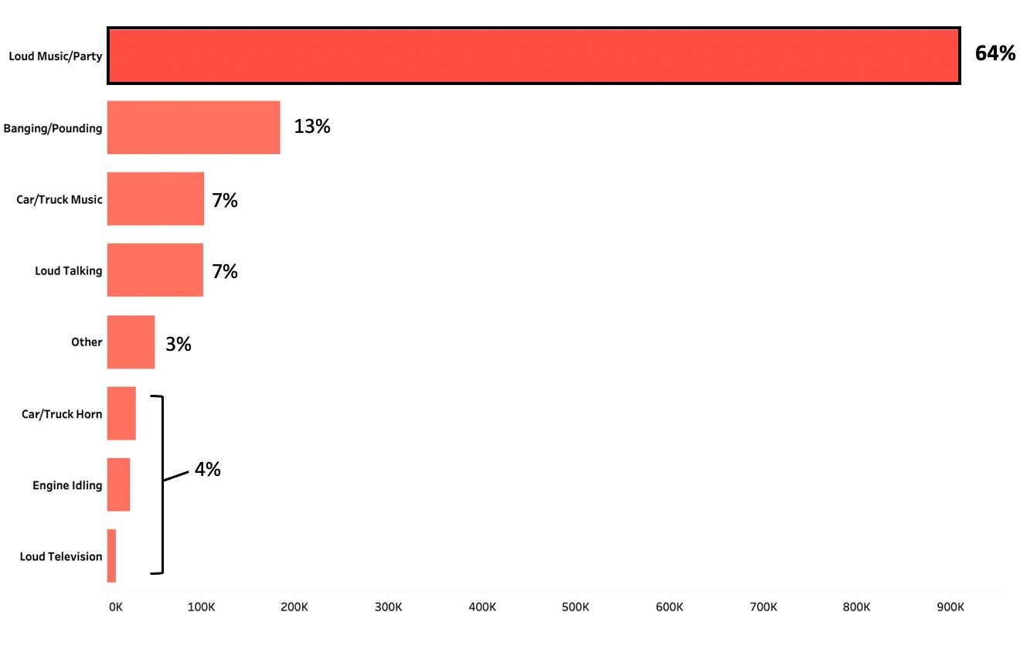
Loud Music from late night parties is the Leading cause for Complaints
Every 2 out of 3 Noise complaints that the New York Police Department receives, are attributed to noise coming from loud music in late night parties.
This is followed by noise coming from banging and pounding assumed due to construction drilling in residential complexes.
A curb on the sound limit during parties is required. Citizens may be encouraged to party in places like restaurants and clubs.
Construction companies are required to restrict any ongoing site work during non- office hours.

Slide 4
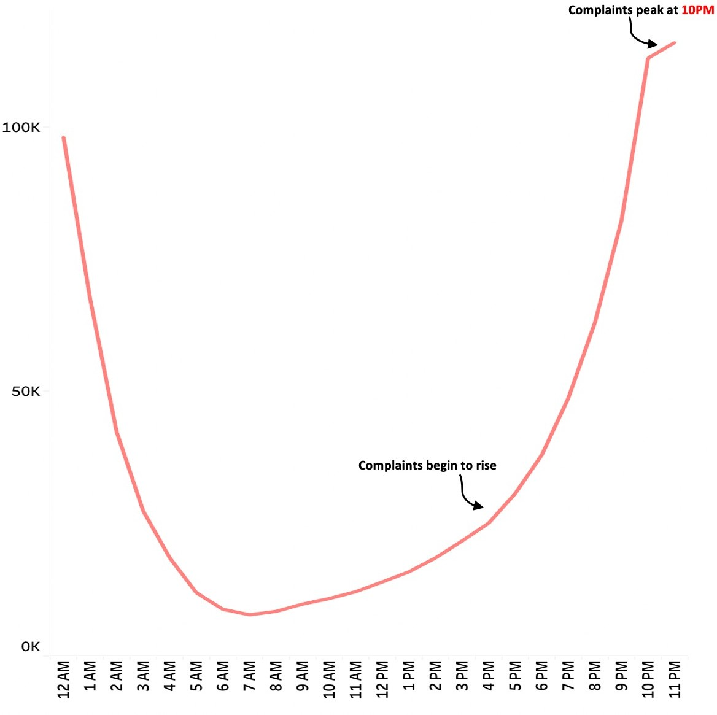
Complaints peak post sunset and wane down before sunrise
According to the sources, complaints rise after 4 PM and fall down during wee hours around 3-4 AM.
This is especially true for late night parties which begin in the evenings and end late nights.
Complaints are likely to stay high even during the nights in the near future if the current situation is not curbed.
Impose decibel limit after sunset. Complete silence hours to be observed between 11PM – 5AM.

Slide 5
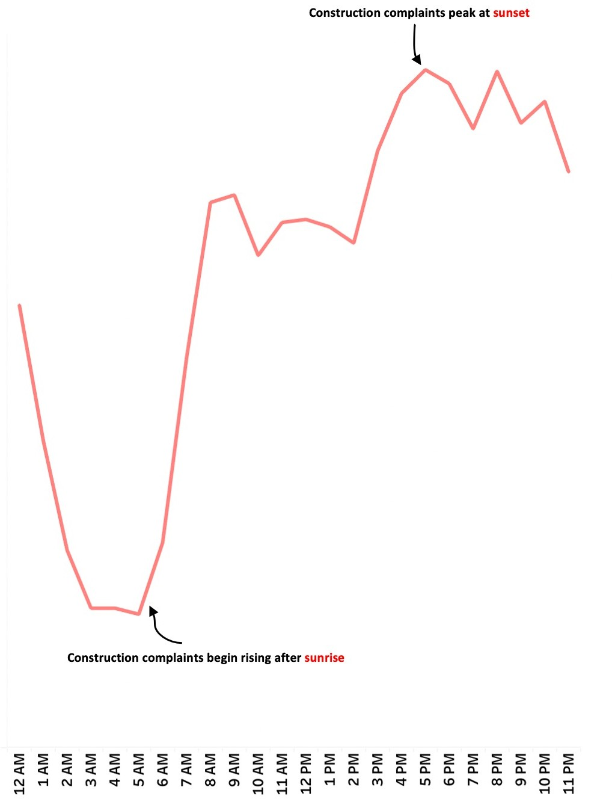
Construction Noise related Complaints rise after sunrise and peak at sunset
For Noise pertaining to Construction, the complaints rise after sunrise and peak by sunset, and they stay high throughout the late evening.
It is recommended to restrict all construction activity after sunset in order to reduce the construction related noise and complaints.

Slide 6
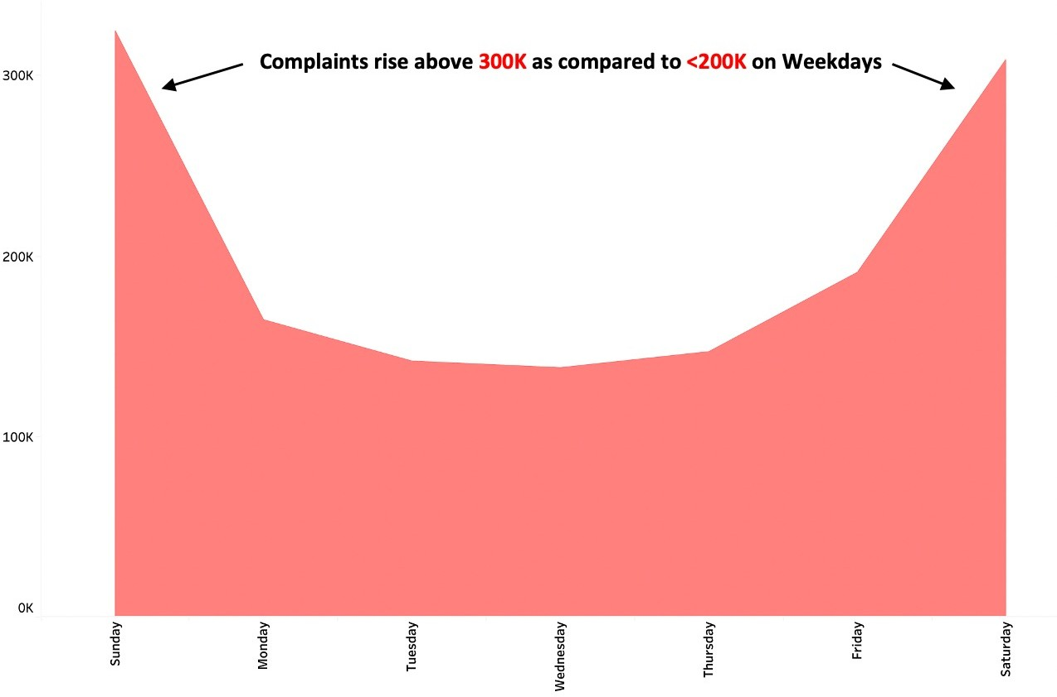
Weekends see the most number of complaints than the rest of the days
Weekends see a spike in average incidents reported, as per sources. Wednesday sees the lowest reporting of incidents while the highest is seen on Sunday.
The spike in incident reporting on weekends may be largely be attributed to weekend late night parties (since weekend is a suitable time to party and most working professionals are at home).

Slide 7
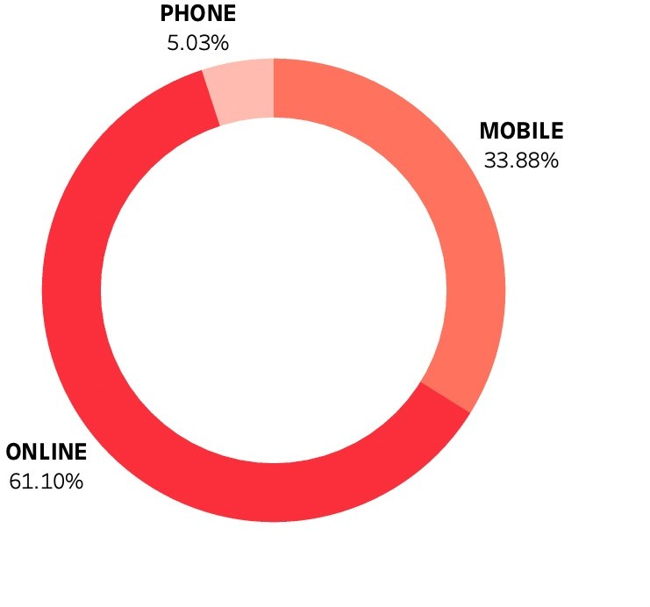
Citizens prefer to use NYPD website to report incidents
Citizens report every 2 out of 3 incidents through the New York Police Department website.
We expect that citizens will use the NYPD portal more frequently in the coming time.
Citizens may also be informed of the NYPD hotline and encouraged to use it, if in emergency.

Slide 8
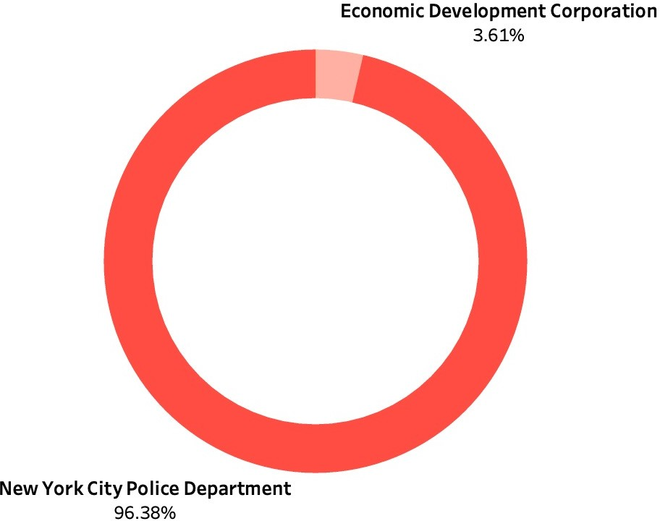
Nearly All of the incidents are reported to NYPD
The NYPD receives nearly all of the incidents from Citizens.
It is estimated that within few years the NYPD might get overburdened with incident reports.
It is advised that trivial incidents must be forwarded to the Economic Development Corporation in order to increase the efficiency of the NYPD.

